Slide 1

Hospital Patient Record System with Data Management Using Structures and Pointer-Based Access
CSA0203 – C Programming
Presented by:
V.Vijay(192525264) A Guna Sekar(192525302) P V Rahul Kavi(192571090)

Slide 2


Abstract
C-based system for efficient hospital patient record management.
Uses structures and pointers for organized data access.
Includes Patient Registration, Medical History, Treatment, and Billing.
Supports CRUD operations – Create, Read, Update, Delete.
Uses dynamic memory allocation for efficient memory management.
Improves data organization, accuracy, and accessibility

Slide 3
Introduction
Hospital records contain important patient and treatment information.
Manual record management can be time-consuming and difficult to maintain.
This project provides a computerized patient record management system.
Structures organize different types of patient information.
Pointers provide efficient access to stored records.
The system simplifies registration, medical history, treatment, and billing.

Slide 4
Problem Statement
Manual records are time-consuming to maintain.
Patient information can be lost or damaged.
Difficult to search and update patient records.
Repeated data entry may cause errors and duplication.
Managing medical history and billing manually is inefficient.
Lack of proper data management reduces accuracy and accessibility.

Slide 5
Existing System
Patient records are mainly maintained using manual files and registers.
Searching patient information is slow and difficult.
Updating records requires repeated manual work.
Records may be lost, damaged, or duplicated.
Medical history and billing information are difficult to manage efficiently.
Limited automation leads to lower accuracy and productivity.

Slide 6
Proposed System
A computerized system for managing hospital patient records.
Uses structures and pointers for efficient data handling.
Provides registration, medical history, treatment, and billing modules.
Supports Create, Read, Update, and Delete (CRUD) operations.
Uses dynamic memory allocation for effective memory utilization.
Provides faster, accurate, and organized patient record management.

Slide 7
Objectives
To develop an efficient patient record management system.
To organize patient data using C structures.
To implement pointer-based data access.
To perform CRUD operations on patient records.
To manage medical history, treatment, and billing efficiently.
To improve data accuracy and accessibility.

Slide 8
System Functionality
Patient Registration – Add and manage patient details.
Medical History – Store and view previous medical records.
Treatment Records – Manage diagnosis, treatment, and prescriptions.
Billing & Payment – Calculate and manage patient bills.
CRUD Operations – Create, Read, Update, and Delete records.
Search & Access – Quickly retrieve required patient information.

Slide 9
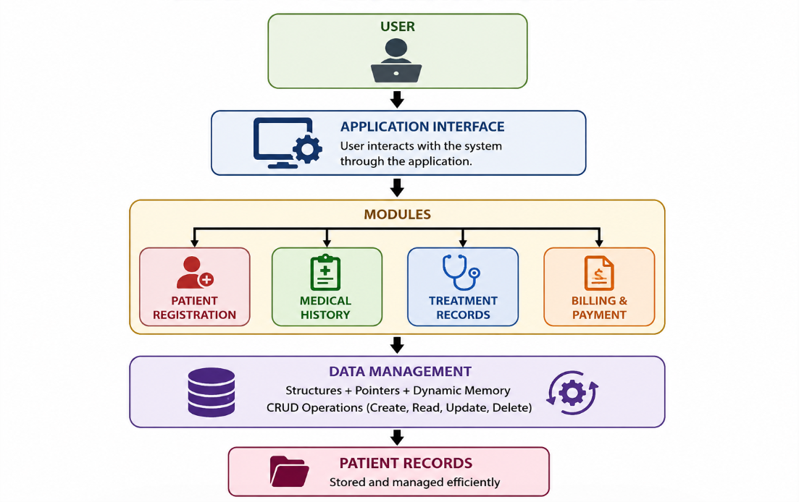
Overall Architecture

Slide 10
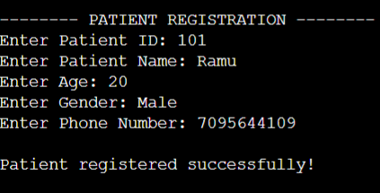
Module 1 – Patient Registration
Add Patient – Enter and store new patient details.
View Patient – Display registered patient information.
Update Patient – Modify existing patient details.
Delete Patient – Remove unwanted patient records.
Uses structures and pointers for efficient record management.

Slide 11
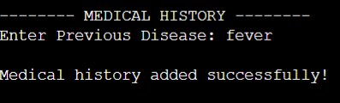
Module 2 – Medical History
Stores the patient’s previous medical records.
Maintains past diseases and health conditions.
Records allergies and important medical information.
Provides quick access to patient medical history.
Supports viewing and updating medical records.

Slide 12
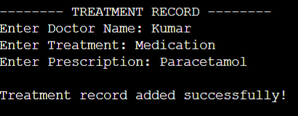
Module 3 – Treatment Record
Records doctor and patient details.
Stores diagnosis and health condition.
Maintains treatment and prescription details.
Records medicines and dosage information.
Allows treatment records to be viewed and updated.

Slide 13
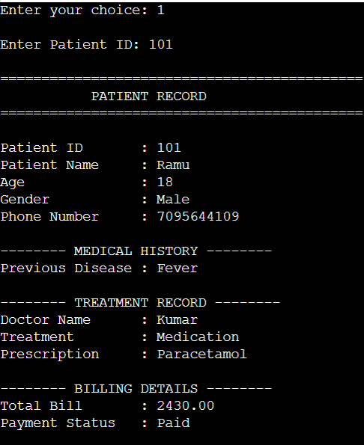
Module 4 – Billing & Payment
Generates patient bills based on treatment and services.
Records payment details and payment status.
Calculates the total bill amount.
Maintains billing records for each patient.
Supports viewing and updating payment information.

Slide 14
Data Structures Used
Structures – Store patient and hospital-related information.
Arrays – Manage multiple patient records efficiently.
Nested Structures – Organize medical history, treatment, and billing details.
Pointers – Access and modify structure data efficiently.
Dynamic Memory – Allocate and release memory when required.

Slide 15
Pointer-Based Access
Pointers store the memory address of patient records.
Use the -> operator to access structure members through pointers.
Enables direct and efficient data access.
Helps modify patient records without copying the entire structure.
Supports dynamic memory management using pointers.
Example: patient_ptr->name; patient_ptr->age;

Slide 16
Dynamic Memory Allocation
malloc() – Allocates a block of memory dynamically.
calloc() – Allocates and initializes memory to zero.
free() – Releases dynamically allocated memory.
Helps use memory efficiently according to requirements.
Supports flexible management of patient records.
Example:
patient = (Patient *)malloc(sizeof(Patient));
free(patient);

Slide 17
CRUD Operations
Create – Add new patient records to the system.
Read – View and retrieve existing patient information.
Update – Modify patient, treatment, or billing details.
Delete – Remove unwanted or outdated records.
Provides efficient and organized record management.

Slide 18
System Workflow & Testing
System Workflow
Start → Patient Registration → Medical History → Treatment → Billing & Payment → Record Update/View → End
Testing
Test patient registration with valid details.
Verify medical history and treatment records.
Check billing and payment calculation.
Test CRUD operations for correct results.
Verify invalid inputs and error handling.
Result: System functions correctly and manages patient records efficiently.

Slide 19
Outcomes & Future Enhancements
Outcomes
Improved C programming and problem-solving skills.
Efficient management of patient records.
Practical understanding of structures and pointers.
Better understanding of dynamic memory allocation.
Effective implementation of CRUD operations.
Future Enhancements
Add a database for permanent record storage.
Develop a web/mobile interface.
Add user authentication and security.
Enable online appointment management.

Slide 20
Conclusion
The system provides efficient and organized patient record management.
Structures and pointers enable effective data storage and access.
CRUD operations simplify record management.
Modules integrate registration, medical history, treatment, and billing.
The project improves programming skills, memory management, and problem-solving.

Slide 21
References
The C Programming Language – Brian W. Kernighan and Dennis M. Ritchie.
C Programming: A Modern Approach – K. N. King.
GeeksforGeeks – C Structures, Pointers and Dynamic Memory Allocation.
Programiz – C Programming Tutorials and References.
W3Schools – C Programming Concepts and Syntax.

Slide 22


